Slide 1


Swapnil Koli
18/02/2025

Slide 2

Outline
Executive Summary
Introduction
Methodology
Results
Conclusion
Appendix

Slide 3
Executive Summary
Summary of methodologies
Summary of all results

Slide 4
Introduction
Project background and context
Problems you want to find answers

Slide 5

Section 1

Slide 6
Methodology
Executive Summary
Data collection methodology:
DatafromSpaceXwasobtainedfrom2sources:
SpaceXAPI(https://api.spacexdata.com/v4/rockets/)
WebScraping (https://en.wikipedia.org/wiki/List_of_Falcon/_9/_and_Falcon_Heavy_launche)
Perform data wrangling
Collected data was enriched by creating a landing outcome label based on outcome data after summarizing and analyzing features

Slide 7
Data Collection
Perform exploratory data analysis (EDA) using visualization and SQL
Perform interactive visual analytics using Folium and Plotly Dash
Perform predictive analysis using classification models
Data that was collected until this step were normalized, divided in training and test data sets and evaluated by four different classification models, being the accuracy of each model evaluated using different combinations of parameters.

Slide 8
Data Collection
Describe how data sets were collected.
Datasets were collected from SpaceX API (https://api.spacexdata.com/v4/rockets/) and from Wikipedia (https://en.wikipedia.org/wiki/List_of_Falcon/_9/_and_Falcon_Heavy_launches), using web scraping technics.

Slide 9
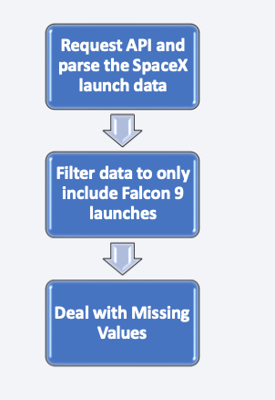
Data Collection – SpaceX API
SpaceX offers a public API from where data can be obtained and then used;
This API was used according to the flowchart beside and then data is persisted.
GitHub URL
https://github.com/swapy1995/IBM-Applied-Data-Science-Capstone/blob/2b2bbed23667c0910471196405b6d393350c6cb8/SpaceX%20API%20And%20Data%20Collection/jupyter-labs-spacex-data-collection-api.ipynb

Slide 10
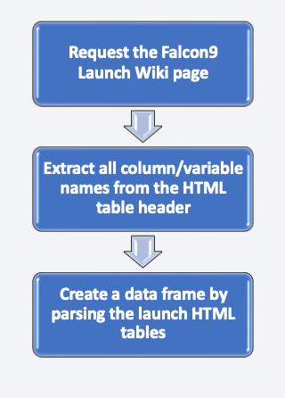
Data Collection - Scraping
Data from SpaceX launches can also be obtained from Wikipedia;
• Data are downloaded from Wikipedia according to the flowchart and then persisted.
GitHub URL
https://github.com/swapy1995/IBM-Applied-Data-Science-Capstone/blob/bf679f1973db9f47b00253591f2804047711047c/Data%20Collection%20-%20Scraping/jupyter-labs-webscraping.ipynb

Slide 11
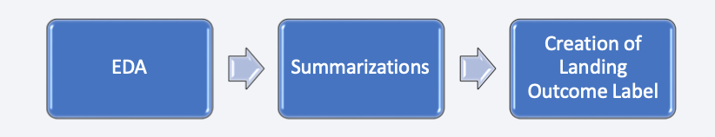
Data Wrangling
Initially some Exploratory Data Analysis (EDA) was performed on the dataset.
Then the summary launches per site, occurrences of each orbit and occurrences of mission outcome per orbit type were calculated.
Finally, the landing outcome label was created from Outcome column.
GitHub URL
https://github.com/swapy1995/IBM-Applied-Data-Science-Capstone/blob/4f8d6fbd93da58a5ce200fbe9b1b5018a51d0f1b/Data%20Wrangling/labs-jupyter-spacex-Data%20wrangling.ipynb

Slide 12
EDA with Data Visualization
The following SQL queries were performed:
Names of the unique launch sites in the space mission;
Top 5 launch sites whose name begins with the string 'CCA’;
Total pay load mass carried by boosters launched by NASA (CRS);
Average payload mass carried by booster version F9 v1.1;
Date when the first successful landing outcome in ground pad was achieved;
Names of the boosters which have success in drone ship and have payload mass between 4000 and 6000 kg;
Total number of successful and failure mission outcomes;
Names of the booster versions which have carried the maximum payload mass;
Failed landing out comes in droneship, their booster versions, and launch site names for in year 2015; and
Rank of the count of landing outcomes (such as Failure (droneship) or Success (ground pad)) between the date 2010-06-04 and 2017-03-20.
GIT URL
https://github.com/swapy1995/IBM-Applied-Data-Science-Capstone/blob/2fb051711effa4e9112738fcc1330e6829a9f9dc/EDA%20with%20Data%20Visualization/edadataviz%20(1).ipynb

Slide 13
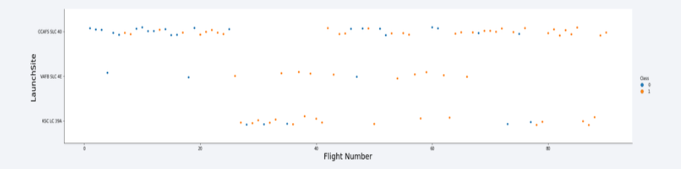
EDA with SQL
To explore data, scatterplots and bar plots were used to visualize the relationship between pair of features:
Payload Mass X Flight Number, Launch Site X Flight Number, Launch Site X Payload Mass, Orbit and Flight Number, Payload and Orbit
GIT URL - https://github.com/swapy1995/IBM-Applied-Data-Science-Capstone/blob/48a181ccd68d066e6d70f85f7f8455643f8f6469/EDA%20-%20With%20SQL/jupyter-labs-eda-sql-coursera_sqllite.ipynb

Slide 14
Build an Interactive Map with Folium
Markers, circles, lines and marker clusters were used with Folium Maps
Markers indicate points like launch sites;
Circles indicate highlighted areas around specific coordinates, like NASA Johnson Space Center;
Marker clusters indicates groups of events in each coordinate, like launches in a launch site; and
Lines are used to indicate distances between two coordinates.
GitHub URL
https://github.com/swapy1995/IBM-Applied-Data-Science-Capstone/blob/28ee7b15cac50ce4c55d32f02ab07501c9afe059/Build%20an%20Interactive%20Map%20with%20Folium/DV0101EN-Exercise-Generating-Maps-in-Python.ipynb

Slide 15
Build a Dashboard with Plotly Dash
We built an interactive dashboard with Plotly dash
We plotted pie charts showing the total launches by a certain sites
We plotted scatter graph showing the relationship with Outcome and Payload Mass (Kg) for the different booster version.
GitHub URL
https://github.com/swapy1995/IBM-Applied-Data-Science-Capstone/blob/bc795dc0729812fe621cbb7be8d253d2776c2526/Plotly%20Dash/spacex_dash_app.py

Slide 16
Predictive Analysis (Classification)
We loaded the data using numpy and pandas, transformed the data, split our data into training and testing.
We built different machine learning models and tune different hyperparameters using GridSearchCV.
We used accuracy as the metric for our model, improved the model using feature engineering and algorithm tuning.
We found the best performing classification model.
GitHub URL
https://github.com/swapy1995/IBM-Applied-Data-Science-Capstone/blob/9a54931e0e72848f494288b6aba43d32b5c7973a/Predictive%20Analysis/SpaceX_Machine%20Learning%20Prediction_Part_5.ipynb

Slide 17
Results
Exploratory data analysis results:
Space X uses 4 different launch sites;
The first launches were done to Space X itself and NASA;
The average payload of F9 v1.1 booster is 2,928 kg;
The first success landing outcome happened in 2015 fiver year after the first launch;
Many Falcon 9 booster versions were successful at landing in drone ships having payload above the average;
Almost 100% of mission outcomes were successful;
Two booster versions failed at landing in drone ships in 2015: F9 v1.1 B1012 and F9 v1.1 B1015;
The number of landing outcomes became as better as years passed.

Slide 18
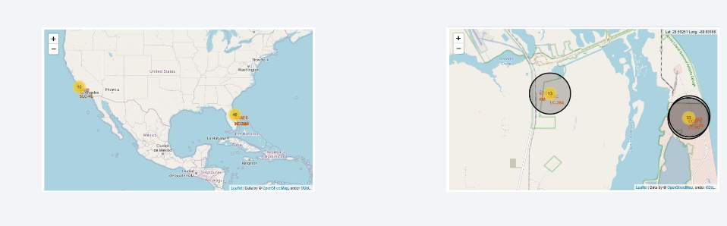
Results
Using interactive analytics was possible to identify that launch sites use to be in safety places, near sea, for example and have a good logistic infrastructure around.
Most launches happens at east cost launch sites.

Slide 19

Section 2

Slide 20

Flight Number vs. Launch Site
From the plot, we found that the larger the flight amount at a launch site, the greater the success rate at a launch site.

Slide 21

Payload vs. Launch Site

Slide 22

Success Rate vs. Orbit Type
From the plot, we can see that ES-L1, GEO, HEO, SSO, VLEO had the most success rate.

Slide 23

Flight Number vs. Orbit Type
The plot below shows the Flight Number vs. Orbit type. We observe that in the LEO orbit, success is related to the number of flights whereas in the GTO orbit, there is no relationship between flight number and the orbit.

Slide 24

Payload vs. Orbit Type
We can observe that with heavy payloads, the successful landing are more for PO, LEO and ISS orbits.

Slide 25

Launch Success Yearly Trend
From the plot, we can observe that success rate since 2013 kept on increasing till 2020.

Slide 26

All Launch Site Names
We used the key word DISTINCT to show only unique launch sites from the SpaceX data.

Slide 27

Launch Site Names Begin with 'CCA'
We used the query above to display 5 records where launch sites begin with `CCA`

Slide 28

Total Payload Mass
We calculated the total payload carried by boosters from NASA as 45596 using the query below

Slide 29

Average Payload Mass by F9 v1.1
We calculated the average payload mass carried by booster version F9 v1.1 as 2928.4

Slide 30

First Successful Ground Landing Date
We observed that the dates of the first successful landing outcome on ground pad was 22nd December 2015

Slide 31

Successful Drone Ship Landing with Payload between 4000 and 6000
We used the WHERE clause to filter for boosters which have successfully landed on drone ship and applied the AND condition to determine successful landing with payload mass greater than 4000 but less than 6000

Slide 32

Total Number of Successful and Failure Mission Outcomes
We used wildcard like ‘%’ to filter for WHERE MissionOutcome was a success or a failure.

Slide 33

Boosters Carried Maximum Payload
List the names of the booster which have carried the maximum payload mass
Present your query result with a short explanation here

Slide 34

2015 Launch Records
We used a combinations of the WHERE clause, LIKE, AND, and BETWEEN conditions to filter for failed landing outcomes in drone ship, their booster versions, and launch site names for year 2015

Slide 35

Rank Landing Outcomes Between 2010-06-04 and 2017-03-20
We selected Landing outcomes and the COUNT of landing outcomes from the data and used the WHERE clause to filter for landing outcomes BETWEEN 2010-06-04 to 2010-03-20.
We applied the GROUP BY clause to group the landing outcomes and the ORDER BY clause to order the grouped landing outcome in descending order.

Slide 36

Section 3

Slide 37

All launch sites global map markers

Slide 38

Markers showing launch sites with color labels
Replace <Folium map screenshot 2> title with an appropriate title
Explore the folium map and make a proper screenshot to show the color-labeled launch outcomes on the map
Explain the important elements and findings on the screenshot

Slide 39

Launch Site distance to landmarks

Slide 40

Section 4

Slide 41

Pie chart showing the success percentage achieved by each launch site

Slide 42

Pie chart showing the Launch site with the highest launch success ratio

Slide 43

Scatter plot of Payload vs Launch Outcome for all sites, with different payload selected in the range slider

Slide 44

Section 5

Slide 45

Classification Accuracy
The decision tree classifier is the model with the highest classification accuracy

Slide 46

Confusion Matrix
The confusion matrix for the decision tree classifier shows that the classifier can distinguish between the different classes. The major problem is the false positives .i.e., unsuccessful landing marked as successful landing by the classifier.

Slide 47
Conclusions
We can conclude that:
The larger the flight amount at a launch site, the greater the success rate at a launch site.
Launch success rate started to increase in 2013 till 2020.
Orbits ES-L1, GEO, HEO, SSO, VLEO had the most success rate.
KSC LC-39A had the most successful launches of any sites.
The Decision tree classifier is the best machine learning algorithm for this task.

Slide 48
Appendix
Include any relevant assets like Python code snippets, SQL queries, charts, Notebook outputs, or data sets that you may have created during this project

Slide 49


